Slide 1

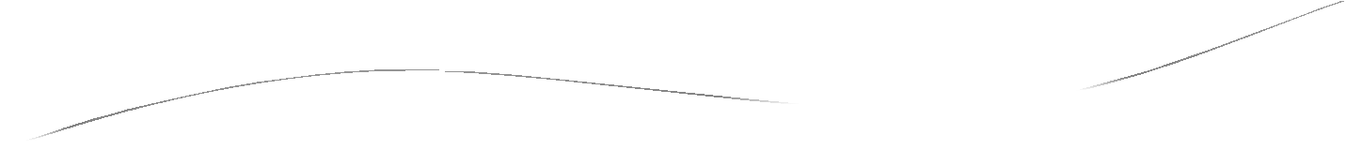

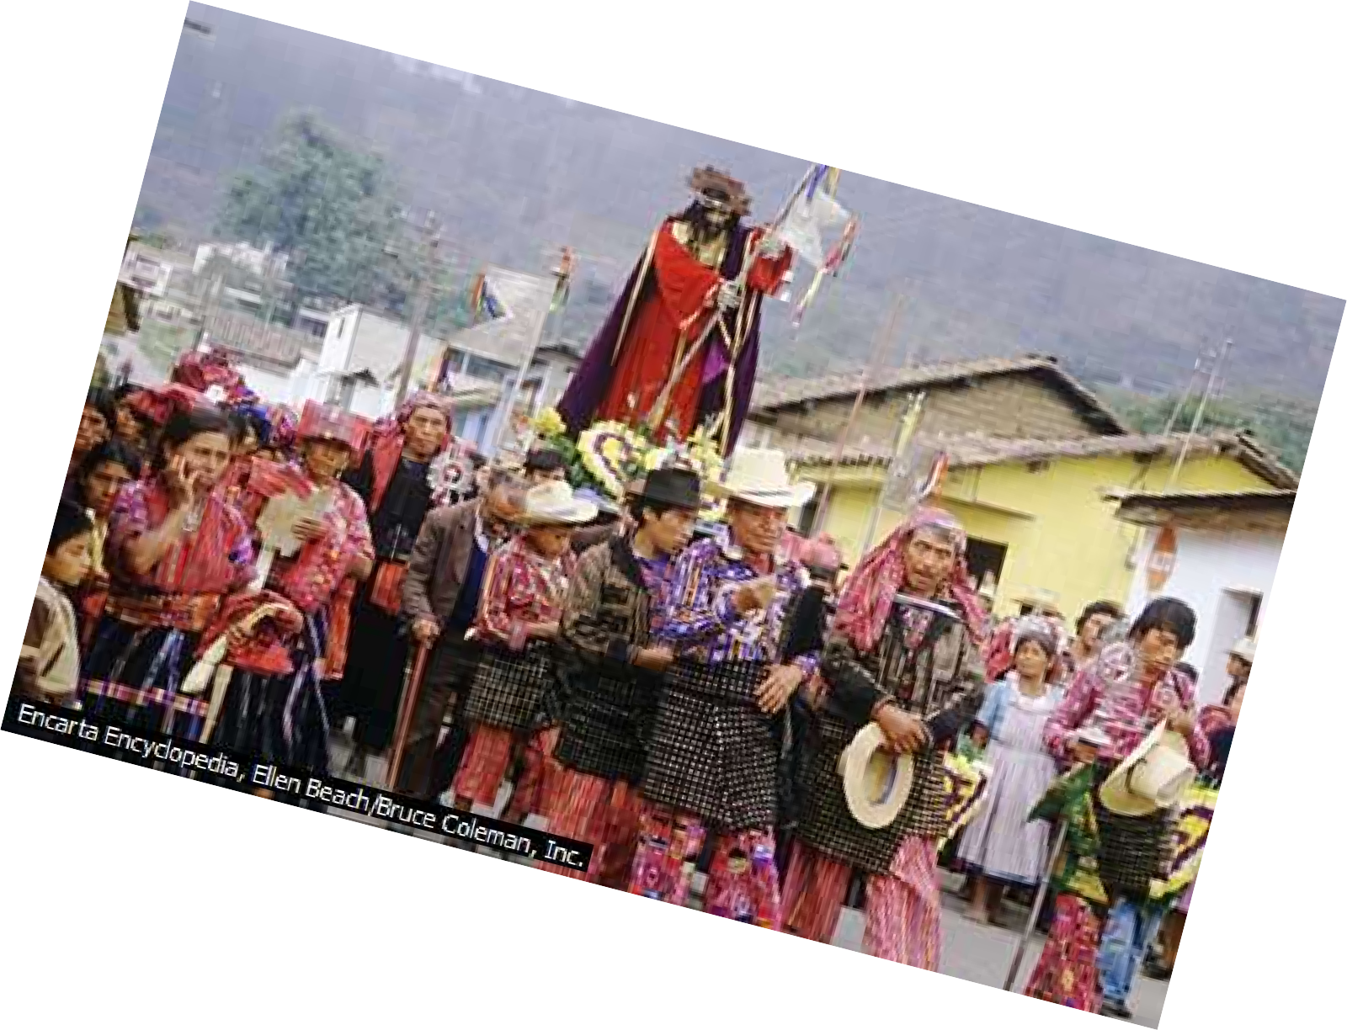

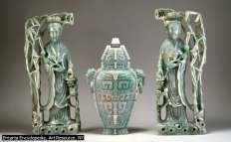
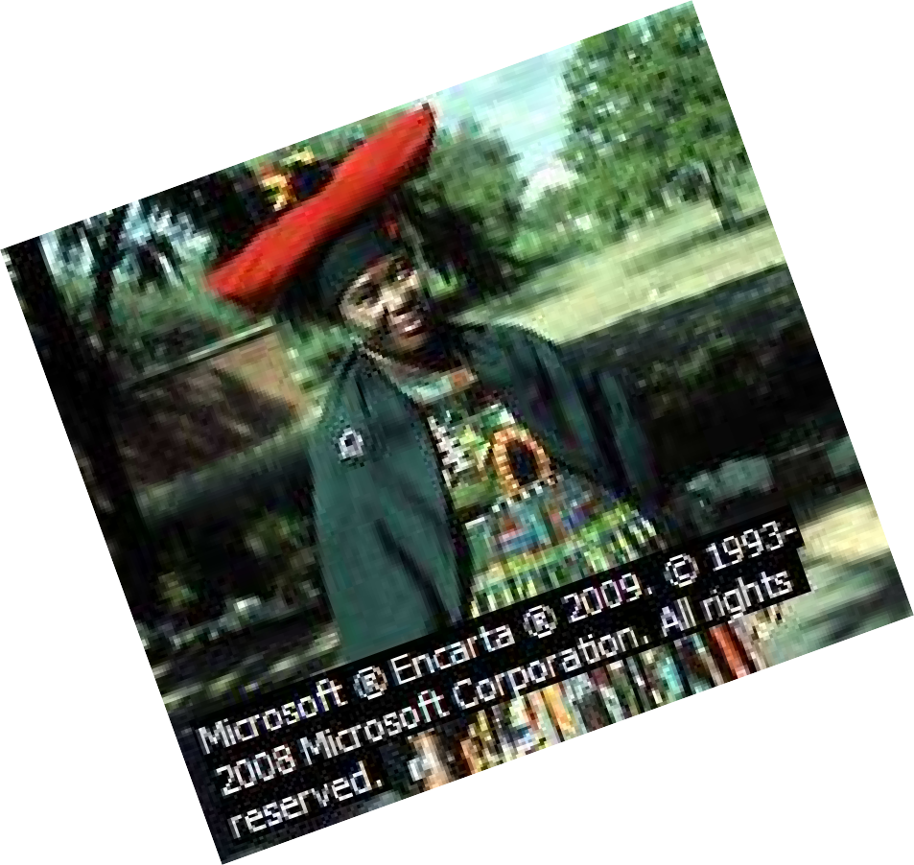
LECTURE #04
COMPONENTS OF CULTURE
DEPARTMENT: CITY AND REGIONAL PLANNING, LCWU
SUBJECT: SOCIOLOGY
COURSE INSTRUCTOR: MS. FARYAL KHALID

Slide 2
COMPONENTS
Culture varies from one another and it shares four major components.
Cognitive Component
Behavioural Aspects
Communication
Material

Slide 3
COGNITIVE COMPONENT
IDEAS/KNOWLEDGE/BELIEFS
The cognitive components of culture consists of definition of what exists, or the reality of the world.
Knowledge is the one part of cognitive culture , refers to ideas and information that can be shown to have empirical, that is objective and factual support. The most highly refined knowledge comes from the physical sciences. A special kind of knowledge, which is directed towards practical application in the physical and social world , is called technology.

Slide 4
Cont..
Knowledge that is less reliable less capable of empirical demonstration is called beliefs. These are ideas or theories about the nature of physical and social world. Beliefs also include idea about supernatural reality such as god , spirits etc.
  Ideas are mental representations (concepts, categories, metaphors) used to organize stimulus; they are the basic units out of which knowledge is constructed and a word emerges.

Slide 5
NORMATIVE/BEHAVIORAL COMPONENT
The normative component of culture consists of definition of what ought to be .Included are values and specific rules of conduct (norms) by which human behaviour is guided and regulated.
Many parts of culture consist of both cognitive and normative components. The leading ideologies of our time democracy, capitalism, communism, socialism which directly or indirectly shape much human behaviour in the world, are large system of ideas that defines both what is or exists, and what ought to be.

Slide 6
NORMS
Norms are rules and expectations by which a society guides the behaviour of its members.
Norms are standards that define the obligatory and expected behaviours of people in various situations.

Slide 7
TYPES OF NORMS
MORES
They are customary behaviour patterns or folkways which have taken on a moralistic value. This includes respect for authority, marriage, religious rituals, and other codes of human behaviour.
LAWS.
Laws constitute the most formal and important norms. Laws are the mores deemed so vital to dominant interests that they become translated into legal formalizations that even non members of society are required to obey.

Slide 8
Cont..
FOLKWAYS.
These are behaviour patterns of society which are organized and repetitive. The key feature of all folkways is that there is no strong feeling of right or wrong attached to them. They are simply the way the people usually do things.
TABOO
A taboo is a norm that society holds so strongly that violating it results in extreme disgust. Often times the violator of the taboo is considered unfit to live in society . For instance, in some Muslim cultures , eating pork is taboo because pig is considered unclean.

Slide 9
COMMUNICATION
LANGUAGE
It forms the core of all culture. When people share a language, they share a condensed, very flexible set of symbols or meanings. That makes communication possible.

Slide 10

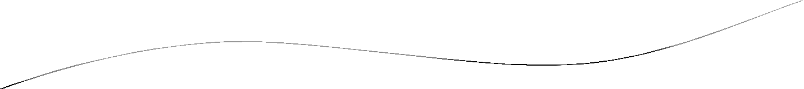
SYMBOLS
Symbols form the backbone of symbolic interaction. They condense very complex ideas and values into simple material forms so that the very presence of the symbol evokes the signified ideas and values.
A symbol is anything that carries a particular meaning recognized by people who share culture.

Slide 11
Cont..
A common one is shaking hand , which is done in some societies but not in others. Its commonly conveys friendship and is used as a sign of both greeting and departure.
Probably all societies have non verbal symbols we cal gestures, movements of hands, arms or other parts of the body that are meant to convey certain ideas or emotion.
However same gestures can mean one thing in one society and something quite different in another society. In united states, if we nod our head up and down we mean yes and if we shake it back and forth , we mean no. In Bulgaria , however , nodding means no, while shaking our head back and forth means yes

Slide 12
MATERIAL COMPONENT
Human make objects, sometimes for practical reasons, and sometimes for artistic ones. The form and function of these objects is an expression of culture and culturally defines behavior often depends on the presence of specific objects. We call such objects material culture.

Slide 13
Cont..
These Includes Homes, neighborhoods, cities, schools, churches, temples, mosques, offices, factories, good and product, means of production etc

